Slide 1

Malaria Image Recognition
Wesley Stanis

Slide 2
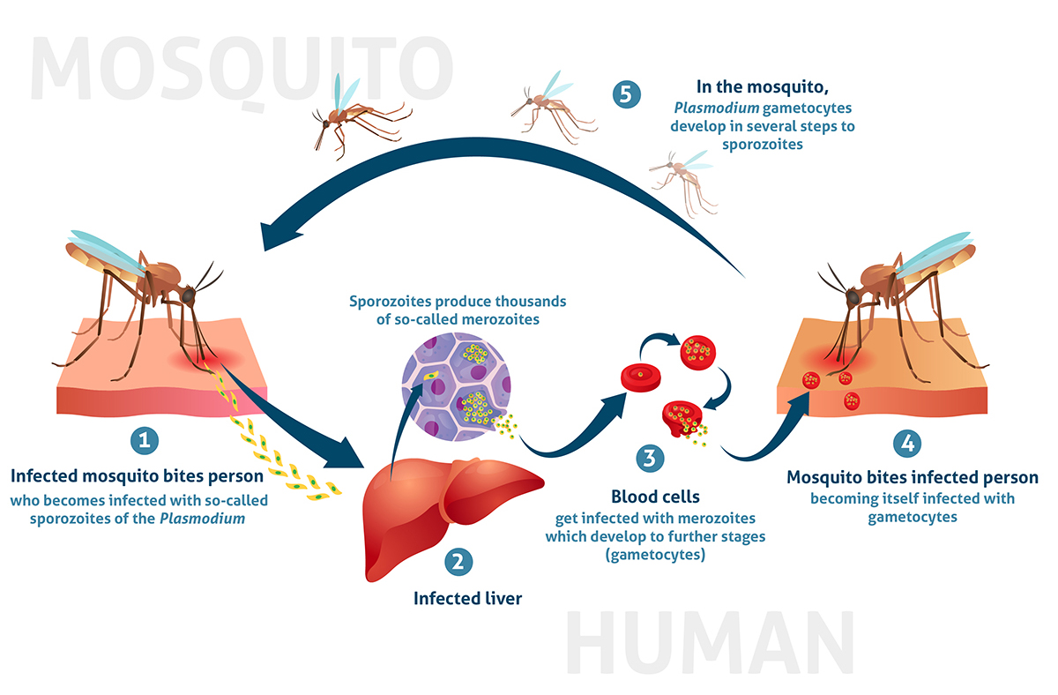
What is Malaria
Malaria is a disease caused by a parasite that is usually transmitted by mosquitos.
Sometimes can be fatal
Treated by prescribing drugs
to kill the parasite

Slide 3
Dataset and Model
The dataset contains over 27,000 images of blood cells, split up into ones that are infected with malaria, and ones that are not.
The data originates from the official NLM website.
We are building a Convolutional Neural Network model to classify these images.

Slide 4
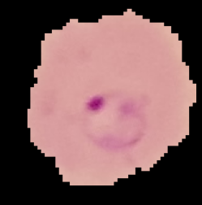
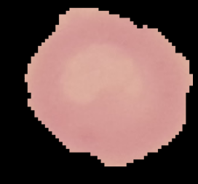
What Our Data Looks Like
Infected
Uninfected
Images were from slide images looking into a microscope

Slide 5
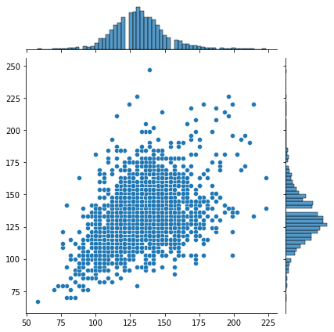
Selecting the Image Size
We needed to transform our data into a single size in order to fit it into our model.
We took the mean of the first 2 dimensions to get an average image size.
The means were:
---131
---131

Slide 6
Image Generator
In order to acquire more images for the model, we took our images and randomly altered them.
This enables us to get more images without having to acquire more data.
Some types of modifications were:
Rotations, adjusting heights and widths, flipping the images, zooming in, etc.

Slide 7

Convolutional Neural Network Model

Slide 8
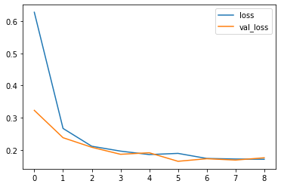
Model
3 Convolutional Layers
3 Pooling Layers
1 Dense layer with 20% Dropout rate
1 Dense layer with Sigmoid function
Loss function is binary cross-entropy
Trained on 10 epochs with patience of 2

Slide 9
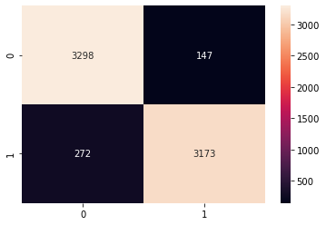
Confusion Matrix and Metrics
0 = infected
1 = uninfected
Predicted values have a threshold of at least 90%
The metric to pay attention to is the False Negative
Metrics:
precision recall f1-score support
0 0.92 0.96 0.94 3445
1 0.96 0.92 0.94 3445

Slide 10
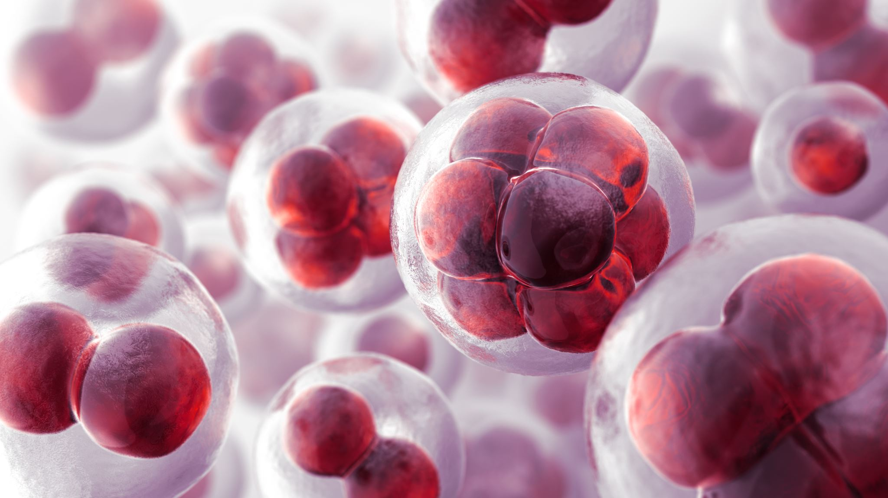
Deployment
The next step would be to deploy this model to new incoming images we receive of blood cells.
We would first need to alter the size of the image to the size we specified for our model.
This could be used to support those in the medical field by possibly assisting them with certain images to focus on.

Slide 11
Thank you

